Slide 1
CS4499/5599: Data Science and Applied Machine Learning
Class Lecture: March 27th, 2023

Slide 2
Objectives
Last time:
Assigned the midproject (due 4/5)
Went over some examples in training DT models
Today:
Go over regression with Decision Trees
Discuss the concept of ensemble machine learning models
Discuss bagging and Pasting
If time permits go over Random Forest

Slide 3
Decision Tree Regression
Decision tree are one of the classification models that can also be used for training regression models
Remember the goal of regression is to determine a value
The concept is the same, we still are looking to split down our data into small pieces until we have a definitive answer
The difference is how we use our equation (CART if we are using Gini Impurity or ID3 if we are using Entropy)
With regression decision trees we calculate MSE for both paths down the tree (we can have more, if we want)

Slide 4
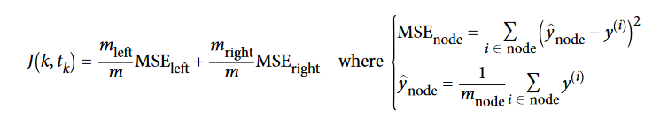
Decision Tree Regression
The goal is to minimize the MSE instead of the impurity
The CART algorithm uses the cost function following equation:
Regression decision trees have the same pros and cons as classification trees
This includes the tendency to become overfit easily and require tuning to produce better models

Slide 5
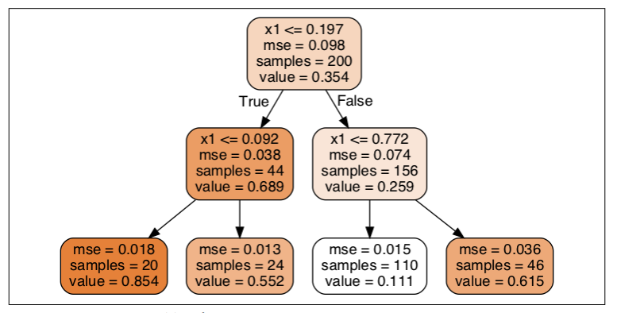
Sample Regression Tree Plot
Notice that each node predict a value
Assume we have a x1 value of 0.6. What is the predicted value?
This is the average target value of the number of samples
Notice we also have a validation value to work with as well (MSE)
Source: Geron textbook

Slide 6
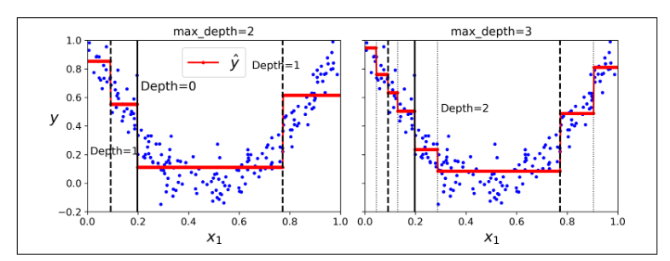
Decision Tree Regression
Let’s look at a graph of the predictions:
The prediction is always the average target value of the points in that region

Slide 7
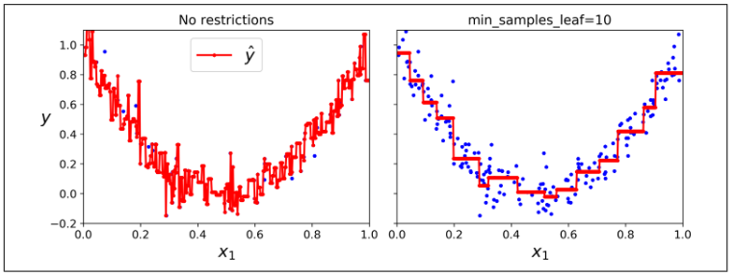
Decision Tree Regression
Now let’s compare an overfit regression model with a “pruned” model:
Just as was the case with linear regression, we don’t want major fluctuation

Slide 8
Ensemble Learning
Consider a complex problem you are looking to get a solution for
What are some strategies you might use to get an answer?
You may consult with an expert
More ideally you will consult multiple people to get their input and take all the input into consideration
In many cases you will find that a large aggregate will produce better results than a sole expert
This has been referred to as the Wisdom of the Crowd

Slide 9
Ensemble Learning
The same logic applies to machine learning models
You may have a single model that makes good predictions, or you may have a several models that make average predictions
Many of the most power machine learning models, are just an aggregate of several models
In machine learning we refer to use of a group of predictors as an ensemble or ensemble learning

Slide 10
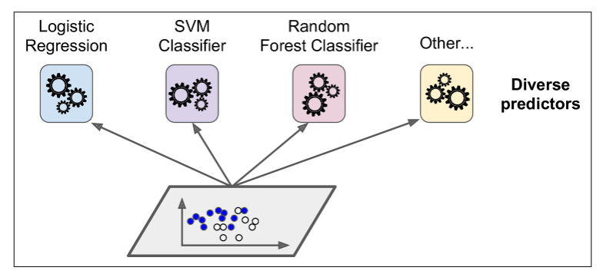
Voting Classifiers
The most basic type of ensemble learning are voting classifiers
In this case you may have several different machine learning models, such as a decision tree, support vector machine, etc.

Slide 11
Voting Classifiers
We can potentially create a better classifier by sample aggregating all of the classification models
This is typically done by majority vote, each model make a separate and independent prediction and the prediction that gets the most votes is the decision
In many cases this can produce results with higher accuracy, than even the best classifier
The key advantage here is that the models using in the ensemble don’t have to be “strong learners”

Slide 12
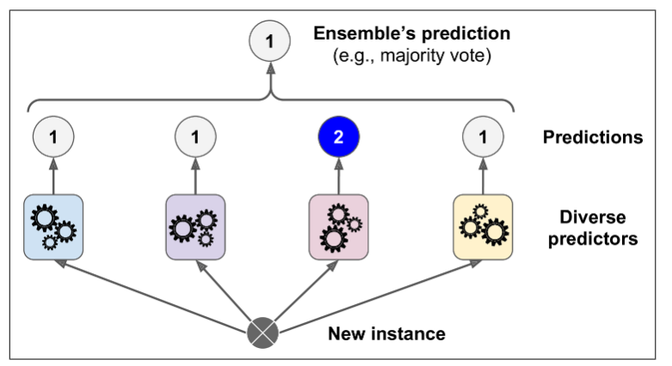
Voting Classifiers
Even if the ensemble is made up of only “weak learners”, as long as you have enough models you can get good results

Slide 13
Voting Classifiers
You might be wondering if this is actually true
Geron gives a good analogy to demonstrate how a group of weak learners can provide effective models
First consider a slightly biased coin (51% probability of flipping heads, 49% of flipping tails)
If we were to flip the coin 1000 times, what is the value we expect?
In fact, as the number of tosses increases the probability of having a majority of flips come out head increases (if we worked through the math, it would around 75% for n=1000)

Slide 14
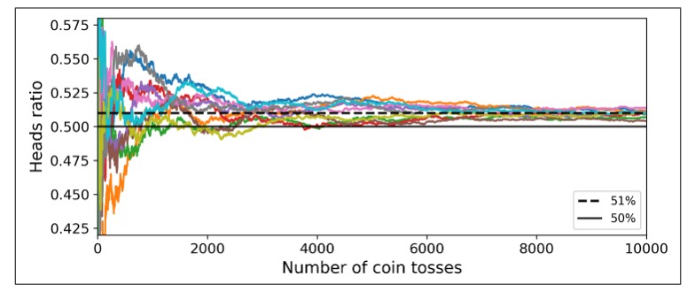
Voting Classifiers
If you look at our figure your will notice, that fluctuations decrease (by n=8000 to 10000 are ratio is what we expect)
This is due to the Law of Large Numbers

Slide 15
Voting Classifiers
Now the same concept applies in machine learning
If I train 1000 classifiers that are correct only 51% of the time (assuming binary classification), then the probability of a correct classification will be fairly high (again around 75%)
Now there is a major catch, this assumes our models are completely independent
This is very unlikely since we are using the same data to train the classifiers and will likely get tripped up by the same thing, so the impact on accuracy will likely not be as dramatic

Slide 16
Voting Classifiers
To improve you chances of training a higher quality model, you want to use as many different classifiers as possible
We will spend the next week or so going over several other common supervised learning models that you could potentially use?
Scikit Learn has a useful class for majority voting classification sklearn.ensemble.VotingClassifier()
By default, the class uses majority vote, but the class allows you to specify the weights for each classifier used if that is a consideration

Slide 17
Ensemble Regression
Ensemble methods are not limited to just classification, we apply this technique to regression models
With ensemble regression, we still train multiple models to determine our value
Once we have our predicted values from our models, we simply average out the result to get our prediction
The sklearn class for voting regression is sklearn.ensemble.VotingRegressor()

Slide 18
Bagging & Pasting
One of the challenges with ensemble learning is getting enough classifiers,
If you do not have enough there is a chance that your model will occasionally lean toward the incorrect choice
Of course, we could spend hours training different classifiers until we are confident, but there is a better solution
Instead, we could use the same algorithm and train it on different (random) subsets of our training data
When training is performed with replacement, it is known as bootstrapping or more commonly bagging

Slide 19
Bagging & Pasting
If we decide not to replace the data, it is known as pasting
Both approaches give us the ability to train the same sample across different predictors, but bagging allows us to use the sample multiple times for the same predictor
Using bagging and/or pasting give us multiple predictions we can aggregate, just like we did with the VoterClassifier
Usually, bagged models have lower variance and similar bias to single predictors
An advantage of bagging is the ability to utilize multi-core CPUs, Cloud Computing or other forms of parallel processing

Slide 20
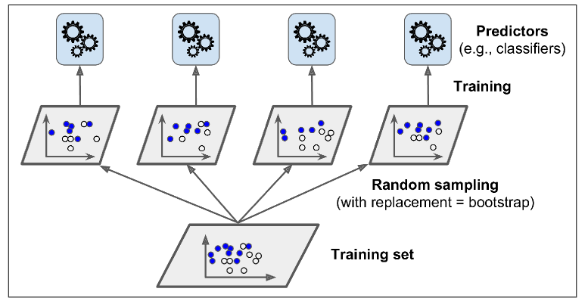
Bagging & Pasting

Slide 21
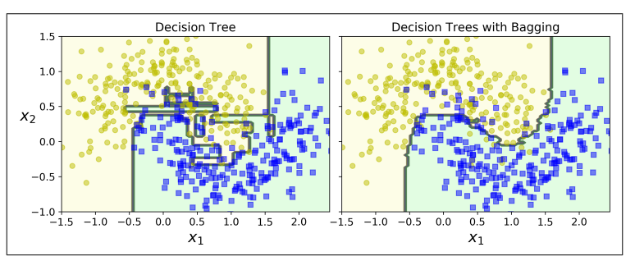
Bagging & Pasting
If we compare a standard decision tree model to that with one that uses bagging, what do we see?

Slide 22
Bagging & Pasting
It is likely that the single decision tree may perform slightly better than the bagged decision tree
However, the bagged tree as we saw above generalizes much better, this is far more valuable that a point of accuracy
When using bagging the extra diversity added to the dataset can add bias to the data (slightly) than if we just used pasting
However, this also gives us predictors that are less correlated, so variance is reduced
Generally boosting is faster and gives “better” models, but you can cross validate the two models and compare to make a decision on which model to use

Slide 23
Out of Bag Evaluation
One potential issue with bagging is that some sample can be repeated, while other may not be used at all
On average the percentage of total samples used when training a bagging model might be as low as 63%
The remaining samples are commonly referred to as out of bag samples
It is possible to evaluate a model with these data points, the BaggingClassifier has a parameter “obb” that can be set to true
When enabled we can score the model based on these points

Slide 24
Random Patches & Subspaces
The sklearn’s BaggingClassifier also supports the sampling of features within a dataset
This is controlled with two hyperparameters max_features and bootstrap_features
Utilizing both random instances and features is known as random patches, while sampling only features is known as random subspaces
When these are used the model will be trained with a random subset of features
This is useful if you are working with high dimension data and need to manage overfit

Slide 25
Next Time
Continue discussing classification in machine learning
Continue with ensembles with Random Forest Models and Boosting
Remember the midproject is due next Wednesday on 4/5

